Slide 1


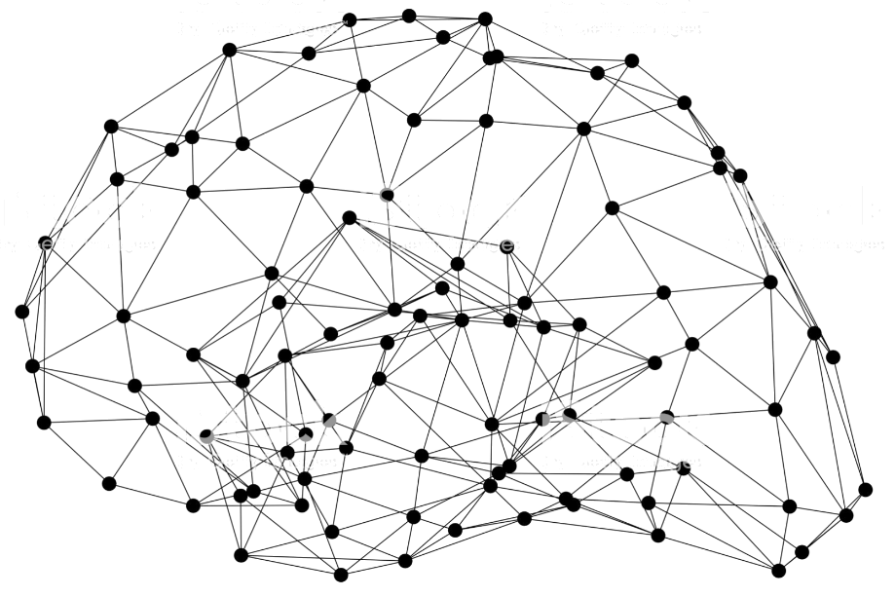
Machine Learning on AWS
Emily Webber
Machine Learning Specialist SA
Amazon Web Services
Notes:
Amazon SageMaker is a fully managed service that allows developers and data scientists can use to build, train, and deploy machine learning models. There are a lot of components to SageMaker, whether you’re using the manged development environments, the ephemeral training clusters, the hyperparamter tuning, or the deployed endpoint

Slide 2
Architecting for Machine Learning Agenda
Day 1
ML on AWS
NLP Lab
Teams
New Problem
Day 2
Feature Engineering
Project
Evaluation
Day 3
Going Into Production
Build
Present!
Write Up
New Model
Architecture

Slide 3

What is a computer?

Slide 4
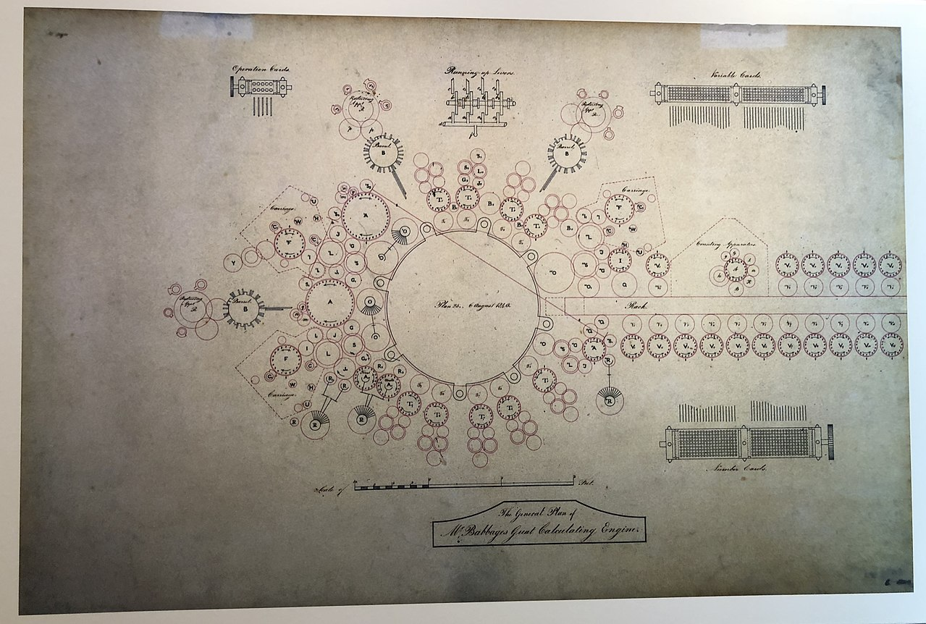
What is a computer?
Analytical Engine

Slide 5
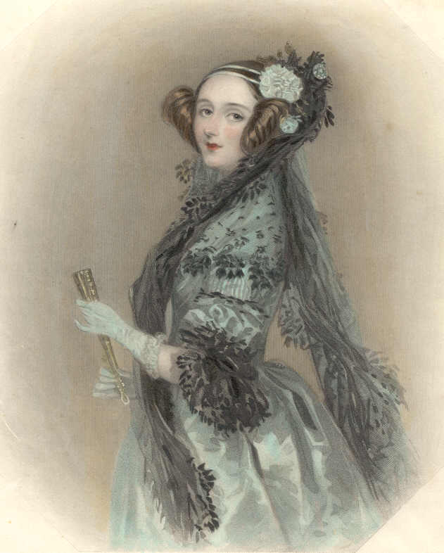
What is a computer?
The Lovelace Critique

Slide 6
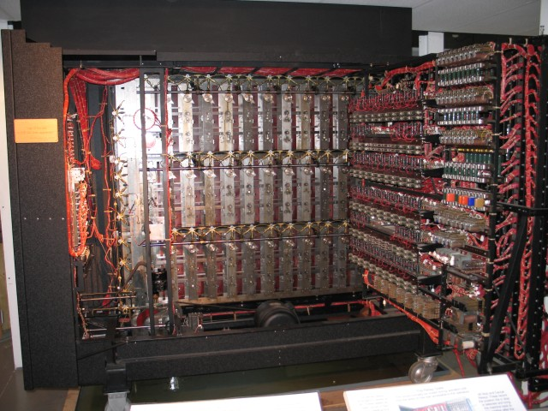
What is a computer?
The Turing Test

Slide 7
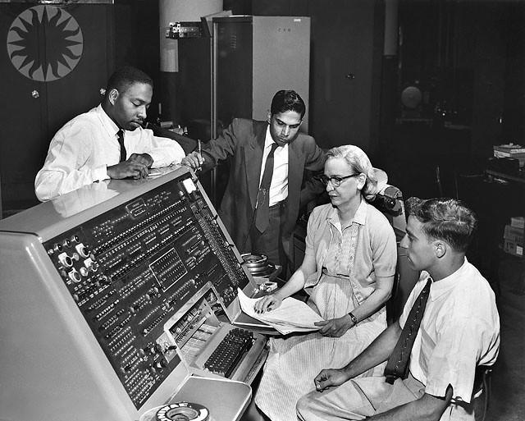
What is a computer?
They told me computers could only do arithmetic.
Admiral Grace Hopper

Slide 8
What is a computer?
Software engineering eventually and necessarily gained the same respect as any other discipline.
Margaret Hamilton

Slide 9

What is a computer?
Katherine Johnson, 1962
Carlos Guestrin, 2016

Slide 10
From day zero in computing, humans have always wanted them to be intelligent
Diversity and inclusion
is the only road to success.

Slide 11
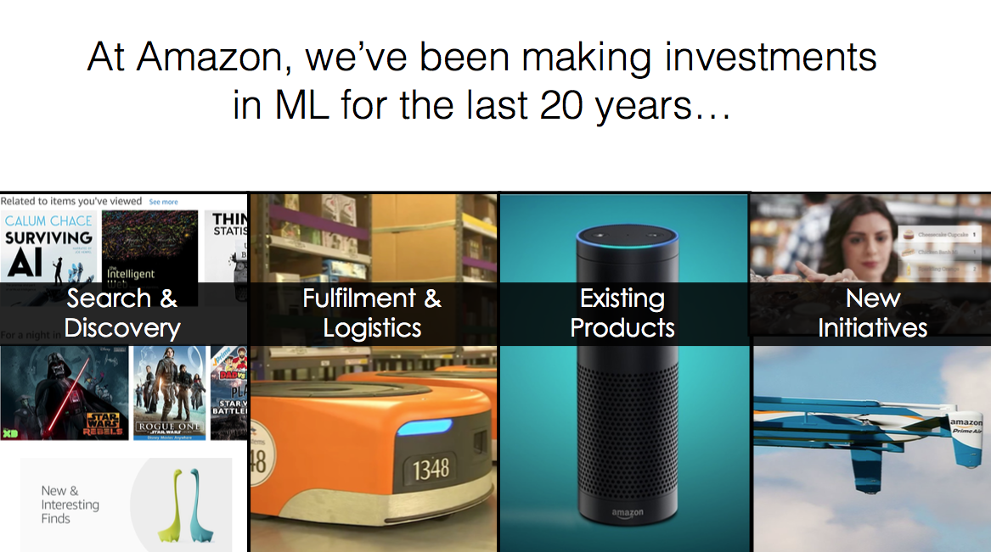
Notes:
What we hope to show here is a trained ”Pareto” model. We want to send new economic data up to Pareto, and have him suggest an optimal gun control policy setting.
We want to show this on a variety of cases, we’ll send up economic data from multiple states, and from multiple points in time, and look at what he recommends given different policy scenarios
We hope we’ll have a flashy website for this too!
Shoot for a 2-5 minute demo.

Slide 12
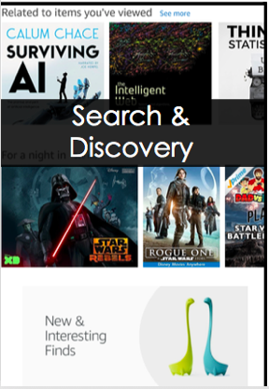
Matrix Factorization
Customers
Products
X
Use the dot product to estimate interactions
Update your learning with real reviews
Look at the impact of temporality!
Deep learning can increase quality

Slide 13
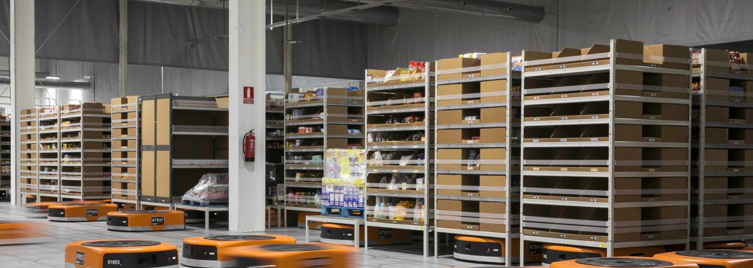
Digital inventory management & robotic item retrieval

Slide 14
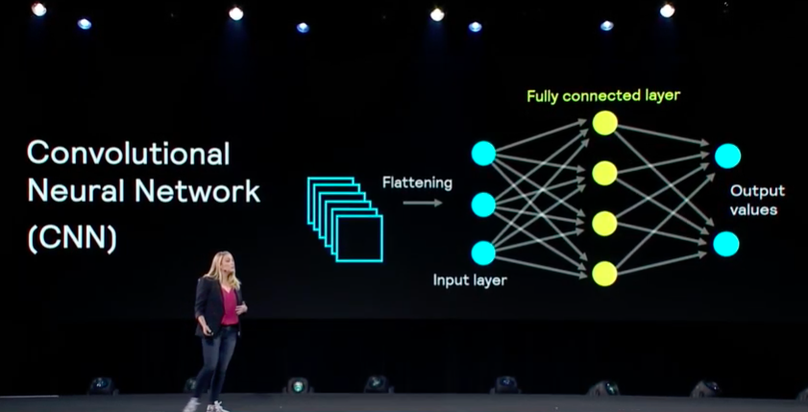

Slide 16
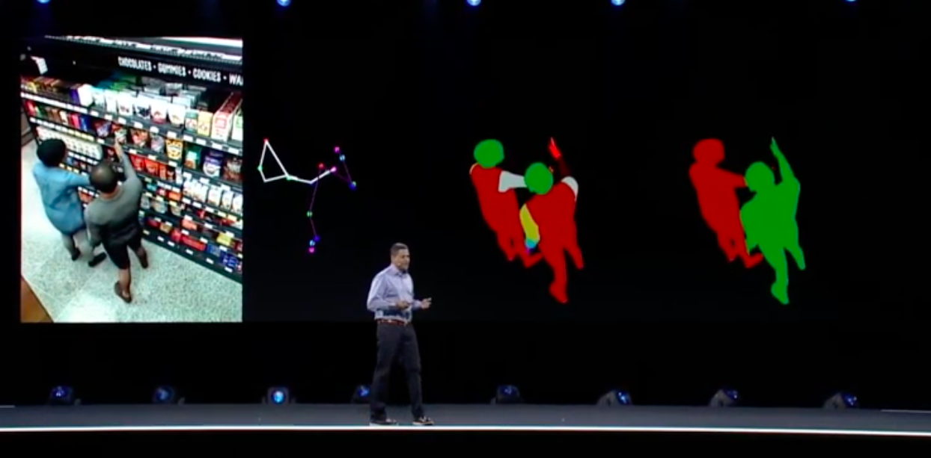
1
4
3
2

Slide 17
AWS Basics for AI/ML
S3 Bucket
EC2 Instances
You!

Slide 18

Our mission at AWS
Put machine learning in the hands
of every developer
Notes:
Our mission is to take our rich experience and expertise with machine learning across Amazon and put it in the hands of all organizations--every developer, data scientist, reseacher.
Said another way, we want to simplify machine learning. We want to make it easy for all developers to easily build intelligent applications

Slide 19
The Amazon Machine Learning stack
Fully-Managed
AWS-Managed
Customer-Managed

Slide 20








The Amazon Machine Learning stack
Frameworks
Interfaces
Infrastructure
EC2 P3 & P3dn
EC2 C5
FPGAs
GREENGRASS
ELASTIC INFERENCE
Customer-Managed

Slide 21

The Amazon Machine Learning stack
AMAZON SAGEMAKER
ALGORITHMS
TRAINING
OPTIMIZATION
(NEO)
MARKETPLACE
GROUND TRUTH
DEPLOYMENT
NOTEBOOKS
REINFORCEMENT LEARNING
AWS-Managed
HOSTING

Slide 22










The Amazon Machine Learning stack
Vision
Language
PERSONALIZE
REKOGNITION
IMAGE
REKOGNITION
VIDEO
TEXTRACT
Speech
TRANSLATE
COMPREHEND &
COMPREHEND MEDICAL
Fully-Managed
POLLY
TRANSCRIBE
LEX
FORECAST

Slide 23
The Amazon Machine Learning stack
Vision
Language
PERSONALIZE
REKOGNITION
IMAGE
REKOGNITION
VIDEO
TEXTRACT
Speech
TRANSLATE
COMPREHEND &
COMPREHEND MEDICAL
Fully-Managed
POLLY
TRANSCRIBE
LEX
FORECAST
AWS-Managed
AMAZON SAGEMAKER
Customer-Managed
EC2 P3 & P3dn
EC2 C5
FPGAs
GREENGRASS
ELASTIC INFERENCE

Slide 24















































































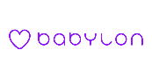


































Machine Learning Customers at AWS

Slide 25


Slide 26
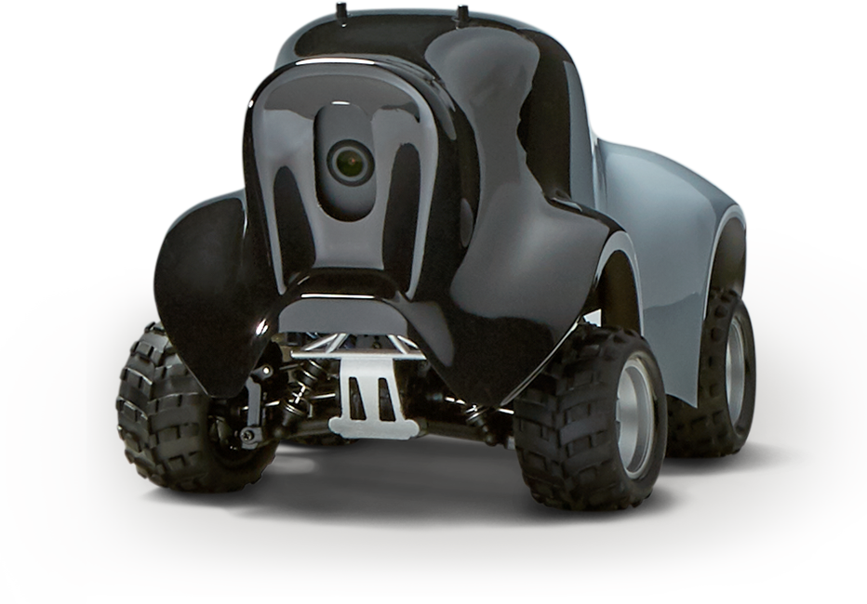
Deep Racer and SageMaker RL

Slide 27
Amazon SageMaker
Deep Dive
Notes:
Overview

Slide 28

Center of Machine Learning
Model
Use
Case
Overfitting
Data
Model
Use
Case
Data
Model
Use
Case
Underfitting
Data

Slide 29
Learning Theory Fundamentals
Domain experts who know the use case very well can provide high-quality information
You can incorporate that information into your model as features
Model
Use
Case
Data

Slide 30
Breaking Down the Problem
What data do I have?
Use
Case
Which model should I use?
How do I frame the problem to use models I know?

Slide 31



What is a model?
Math Slide 1/2
$$\frac{1}{1+ e^{−x}}$$
[0, 1]
Logistic
0.1 0.1 0.1 0.1
v
$$Y$$
---
$$Y$$
Layers
0.1 0.1 0.1 0.1 0.1
Inputs
Loss Function
Notes:
What is a model
Loss
Update
Add data
Model

Slide 32

How does a model “learn?”
Math Slide 2/2
$$\frac{1}{1+ e^{−x}}$$
0.5 0.5 0.5 0.5
0.5 0.5 0.5 0.5 0.5
1. Use Stochastic Gradient Descent to find the global minimum of the loss function
With respect to our model inputs.
2. Update the model parameters
By the learning rate
In the opposite direction
To minimize the loss
Notes:
What is a model
Loss
Update
Add data
Model

Slide 33
Machine Learning Lifecycle
Jupyter
Notebook
Build
Manage Deployment
Machine learning algorithms
Deploy
Train
Deploy the model
Model Training
Hyper-Parameter
Tuning

Slide 34
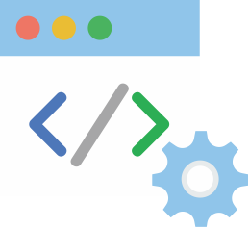

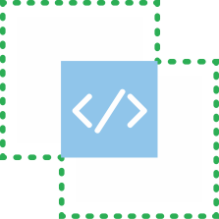


Amazon SageMaker
1
2
3
4
5
$$\frac{1}{1+e^{−x}}$$
I
I
I
I
I
Notebook Instances
with 200+ Examples
17 Built-In Algorithms
ML Training Service x 5
Hyper-Parameter
Tuning Service x 2
ML Hosting Service
6
Batch Transform
Inferencing
Data Transformation
7
SDK’s:
Python
Spark
8
Documentation & White Papers
& Blog Posts

Slide 35
Each algorithm solves a type of prediction problem
Computer Vision
Topic Modeling
Classification
Linear Learner *
XGBoost *
KNN
Factorization Machines
Image Classification <>
LDA
NTM
Object Detection <>
Semantic Segmentation
Recommendation
Forecasting
Factorization Machines * (+ KNN)
DeepAR *
Working with Text
Blazing Text
Supervised
Unsupervised *
Clustering
Anomaly Detection
Random Cut Forests *
Kmeans *
KNN
IP Insights *
Feature Reduction
Sequence Translation
Regression
Linear Learner
XGBoost
KNN
PCA
Seq2Seq *
Object2Vec
* = distributed training
<> = incremental training

Slide 36
Many Ways to Train Models on SageMaker
1 2 3
Built-in Algorithms
Script Mode
Docker container
4 5
AWS ML Marketplace
Notebook instance

Slide 37
Amazon SageMaker | Build

Slide 38
Amazon SageMaker Notebook Instances
Elastic
Inference
EC2 Instance
t, m, c, p, ei families
Jupyter with 1400+ packages
Git repositories
Lifecycle Configuration
200+ examples
AWS Lambda
EBS Volume
Notes:
5. Elastic inference

Slide 39

Notebook Instance Pro Tips
EC2 Instance
EBS Volume
Lambda
Resize on the fly
Multiprocessing
Local Mode
Notes:
Turn off your notebooks when not in use, ideally using a Lambda function
When you realize you need a different resource configuration, you can easily change this out
You can run feature engineering through all the cores on your machines. So if you upgrade to the m5 series, you can get access to 96 cores. When finished, you can wind this back down.
There is a soft limit on the number of jupyter notebooks you’ll have access to. Contact your AWS account team to increase this number when you are creating new environments for your data science teams.
Remember to check in your code to git! You can store backups of your notebook data in S3, but in case your Jupyter environment is compromised with too much data, make sure your code is recoverable.
Revert to previous checkpoints
SageMaker Execution Role

Slide 40
Common Machine Learning Development
Upside:
Flexible. Personal. Easy to get started.
Downside:
Extremely difficult to scale
Nearly impossible to run in production
Need virtual environments in order to experiment
Laptop

Slide 41
Common Machine Learning Development
Upside:
Familiar
Downside:
Availability is incredibly challenging to maintain
Stuck in either over- or under- utilization
Experimentation is risky and expensive
New ideas have to wait for months to start
Good luck going global!
Servers

Slide 42
Dedicated compute per

Slide 43
Amazon SageMaker | Train

Slide 44
Many Ways to Train Models on SageMaker
1 2 3
Built-in Algorithms
Script Mode
Docker container
4 5
AWS ML Marketplace
Notebook instance

Slide 45
SageMaker Training Clusters
Write trained model to S3
Downloads your model
EC2 Instance
Docker Container
S3 Bucket
Sends your data
EC2 Instance
model.fit()
Elastic Container Registry
EC2 Instance
EBS Volume

Slide 46
SageMaker Training Clusters Data Sources
S3 Bucket
FSx For Luster
EFS
Enable versioning
Accelerate transfer
Lifecycle
Visual upload
Etc …
Highly optimized file system
Iterative development from training
Avoid copy from S3 during training
Can connect from notebook to training
Can connect from notebook to training cluster
Ideal when you have large data volumes stored in EFS

Slide 47
SageMaker Spot
Specify a max wait time
SageMaker will default to giving you the lowest possible cost
Store model checkpoints in S3 incase your job is interrupted
Many built-in algorithms automatically revert to a training job
We have examples
Save up to 90%!
EC2 Instance Spot Pricing

Slide 48
But wait, what’s a tuning job?

Slide 49
Hyperparameter Tuning Jobs
Bayesian
Optimizer
Docker Containers
EC2 Instance
EC2 Instance
EC2 Instance
tuner.fit()
Round Count
1/7
EC2 Instance
S3 Bucket
EBS Volume

Slide 50
Hyperparameter Tuning Jobs
AUC?
Bayesian
Optimizer
Docker Containers
EC2 Instance
EC2 Instance
EC2 Instance
Different Hyperparameter Settings
Round Count
2/7

Slide 51
Hyperparameter Tuning Jobs
Round 1/7
78%
AUC
50%
Time in seconds

Slide 52
Hyperparameter Tuning Jobs
Round 2/7
78%
AUC
50%
Time in seconds

Slide 53
Hyperparameter Tuning Jobs
Round 3/7
78%
AUC
50%
Time in seconds

Slide 54
Hyperparameter Tuning Jobs
Round 4/7
78%
AUC
50%
Time in seconds

Slide 55
Hyperparameter Tuning Jobs
Round 5/7
78%
AUC
50%
Time in seconds

Slide 56
Hyperparameter Tuning Jobs
Round 6/7
78%
AUC
50%
Time in seconds

Slide 57
Hyperparameter Tuning Jobs
Round 7/7
78%
AUC
50%
Time in seconds

Slide 58

How do I set up a hyperparameter tuning job?
$$δ$$
Objective Metric
Hyperparameters & Ranges
Job Specs

Slide 59
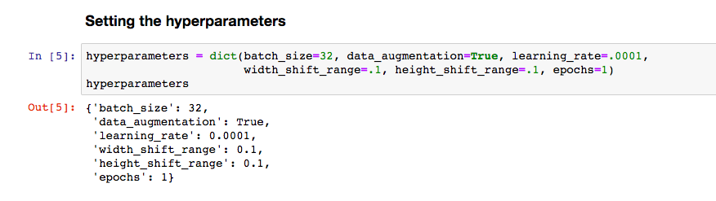
Can I use hyperparameter tuning with my own model?
Docker
Script Mode

Slide 60
What if I need all my jobs tuned at the same time?
Bayesian Search
Random Search

Slide 61
Can I reuse the results of a previous tuning job?
Yes!
Warm Start
Transfer Learning
Run a parent tuning job
Run a parent tuning job
Use transfer learning to add new data!
Run a new job using what you just learned
Copy Job Settings
Run a new job using what you just learned

Slide 62
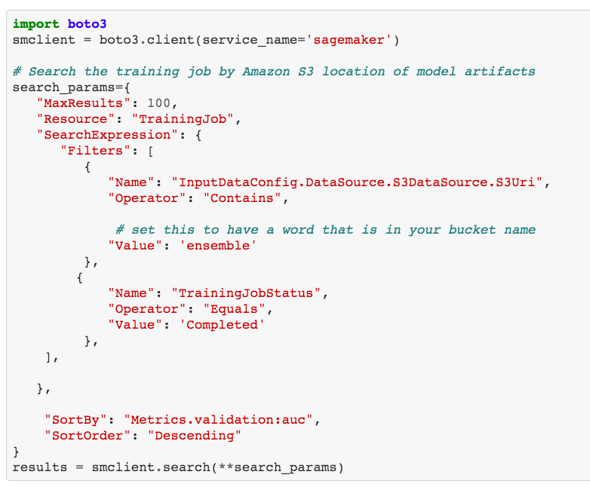
Search across training jobs using the SageMaker API
SageMaker Search

Slide 63
Wait, it’s taking forever to start up my training job, 3 minutes every time! How do I get around that?
Local mode! … Just bring your own model
Customer
Cloud Architect

Slide 64
Script and Local Mode Can Use a Managed Container

Slide 65

Script and Local Mode Can Use a Managed Container

Slide 66
Script and Local Mode Can Use a Managed Container

Slide 67
Script and Local Mode Can Use a Managed Container

Slide 68
Script and Local Mode Can Use a Managed Container

Slide 69
Script and Local Mode Can Use a Managed Container

Slide 70
Script and Local Mode Can Use a Managed Container

Slide 71
How does a managed container work?
script.py
S3 Bucket
S3 Bucket

Slide 72
What can I do with a managed container?
Inference Code
Endpoints
Web Server
Batch Transform
Docker
Inference Pipelines

Slide 73
Local Mode
Requirements:
aws cli
boto3
sagemaker python sdk
access & secret keys

Slide 74
Amazon SageMaker | Deploy

Slide 75
Key Terms in SageMaker Deployment
Endpoint
Batch Transform
Inference Pipeline

Slide 76
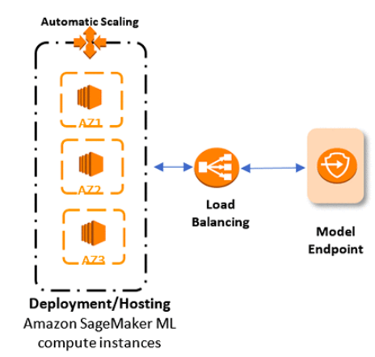
Automatically Create a RESTful API Around Your Model
endpoint = model.deploy(1, ml.m4.xlarge)
payload = json.dumps(your_data)
response = endpoint.predict(payload)

Slide 77
SageMaker Endpoint Key Features
Endpoint configuration
A/B testing with modular, traffic-weighted deployment scheduling
Connect your endpoint to API Gateway, then the internet
You can autoscale your endpoint

Slide 78
Batch Transform Common Design Pattern
Event Trigger
cron job
S3 upload
Lambda Function
S3 Bucket
SageMaker
Write inference results to S3
EC2 Instance
Docker Container
ECR
EC2 Instance

Slide 79
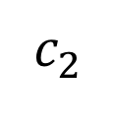
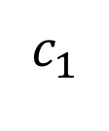
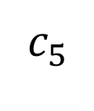
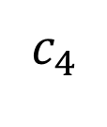
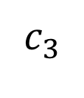
Creating an Inference Pipeline
$$c_{1}$$
$$c_{2}$$
$$c_{3}$$
$$c_{4}$$
$$c_{5}$$
You can deploy up to 5 containers as a ‘PipelineModel’
They will run in serial
They will be co-located on the same EC2 instance

Slide 80
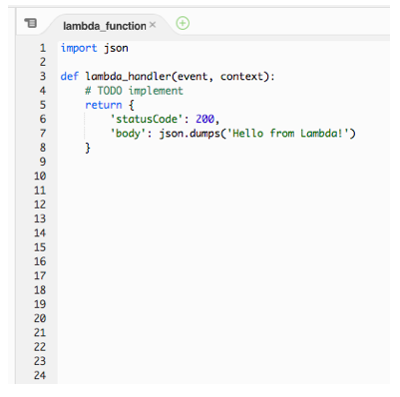
What about using AWS Lamba?
Write your own inference code
Install software package dependencies
Fit within concurrency, time, and size limits

Slide 81
Comparison Points When Deploying on SageMaker
Endpoint
Batch Transform
Inference Pipeline
Best for online streaming
Automatically create a RESTful API
Autoscaling
Seductively easy to create
Manage costs with Lambda
Endpoint configuration
A/B Testing
Can send data to here from anywhere
Sub-second response time
Uses EC2 instances like a training job
Pulls data from S3, runs inference or transformation, writes results to S3
Model still operates like a RESTful API, best for smaller files
Easy to configure with a Lambda function and boto3
Easy to connect to streaming with Kinesis
Can run on both endpoints and batch transform
Will run your data through up to 5 containers
When bringing your own model, you can also bring all your own ETL in the same script
This decision is more about ease of deployment and on-going management
Plug in new models to experiment and innovate very quickly

Slide 82
This is awesome, now I can get a huge model! But wait, how do I fit that on my raspberry pi?
SageMaker Neo!
Customer
Cloud Architect

Slide 83
SageMaker Neo
1. Compresses your model to 1/10 the byte size
2. Helps you configure for specific deployment environments

Slide 84
Thanks!

Slide 85
Architecting for ML
Notebooks

Slide 86
Course Materials: https://tinyurl.com/y3wh4eye

Slide 87
https://tinyurl.com/ya7f6xc9
Account alias: edubz-workshops
Username: Student__#
Password: 2019-2635

Slide 88
Architecting for ML
Problem Discovery

Slide 89
Architecting for Machine Learning Agenda
Day 1
ML on AWS
NLP Lab
Teams
New Problem
Day 2
Feature Engineering
Project
Evaluation
Day 3
Finalize Model
Comparison
Implement
Write Up
New Model
Architecture

Slide 90
The hardest part of machine learning
Is defining the problem.

Slide 91
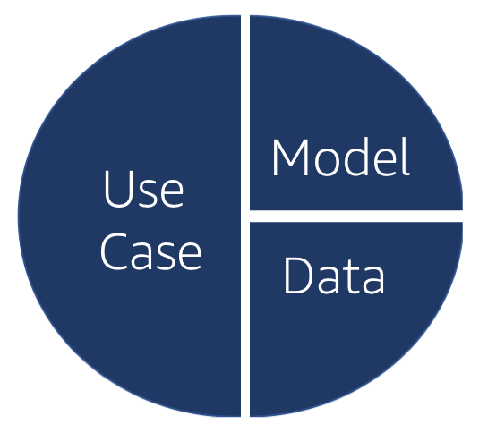
Problem Scoping

Slide 92
Most solutions will require a few algorithms
Classification
Computer Vision
Topic Modeling
Linear Learner
XGBoost
KNN
Image Classification
LDA
NTM
Object Detection
Forecasting
Working with Text
Recommendation
DeepAR
Blazing Text
Supervised
Unsupervised
Factorization Machines
Clustering
KMeans
Sequence Translation
Anomaly Detection
Feature Reduction
Seq2Seq
Random Cut Forests
PCA

Slide 93
Summertime in Chicago
Can we use public data to make the city safer?

Slide 94
Let’s frame this as a classification problem
Neighborhoods x Crimes
Event Data
Join
+
-
Weather Data
Trained
Model Artifact
Linear Learner

Slide 95
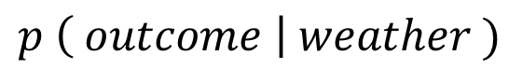
What does classification mean in this context?
New Weather Data
Trained
Model Artifact
$$p \left( outcome \right| weather )$$
We are classifying new data into categories

Slide 96
Example-Project https://github.com/aws-samples/amazon-sagemaker-architecting-for-ml

Slide 97
By the end of today: - Your git repository - Your Project Goal See you tomorrow at 9 am!

